Slide 1
MATLAB for Engineering Applications Fifth Edition
William J. Palm III
© McGraw Hill LLC. All rights reserved. No reproduction or distribution without the prior written consent of McGraw Hill LLC.

Slide 2
Chapter 04
Programming with MATLAB

Slide 3
Algorithms and Control Structures
Algorithm: an ordered sequence of precisely defined instructions that performs some task in a finite amount of time. Ordered means that the instructions can be numbered, but an algorithm must have the ability to alter the order of its instructions using a control structure. There are three categories of algorithmic operations:
Sequential operations: Instructions executed in order.
Conditional operations: Control structures that first ask a question to be answered with a true/false answer and then select the next instruction based on the answer.
Iterative operations (loops): Control structures that repeat the execution of a block of instructions.

Slide 4
Structured Programming
A technique for designing programs in which a hierarchy of modules is used, each having a single entry and a single exit point, and in which control is passed downward through the structure without unconditional branches to higher levels of the structure.
In MATLAB these modules can be built-in or user-defined functions.

Slide 5
Advantages of Structured Programming 1
Structured programs are easier to write because the programmer can study the overall problem first and then deal with the details later.
Modules (functions) written for one application can be used for other applications (this is called reusable code).
Structured programs are easier to debug because each module is designed to perform just one task and thus it can be tested separately from the other modules.

Slide 6
Advantages of Structured Programming 2
Structured programming is effective in a teamwork environment because several people can work on a common program, each person developing one or more modules.
Structured programs are easier to understand and modify, especially if meaningful names are chosen for the modules and if the documentation clearly identifies the module’s task.

Slide 7
Steps for Developing a Computer Solution 1
State the problem concisely.
Specify the data to be used by the program. This is the “input.”
Specify the information to be generated by the program. This is the “output.”
Work through the solution steps by hand or with a calculator; use a simpler set of data if necessary.

Slide 8
Steps for Developing a Computer Solution 2
Write and run the program.
Check the output of the program with your hand solution.
Run the program with your input data and perform a reality check on the output.
If you will use the program as a general tool in the future, test it by running it for a range of reasonable data values; perform a reality check on the results.

Slide 9
Effective documentation can be accomplished with the use of
Proper selection of variable names to reflect the quantities they represent.
Use of comments within the program.
Use of structure charts.
Use of flowcharts.
A verbal description of the program, often in pseudocode.

Slide 10
Documenting with Charts
Two types of charts aid in developing structured programs and in documenting them.
These are structure charts and flowcharts.
A structure chart is a graphical description showing how the different parts of the program are connected together.

Slide 11
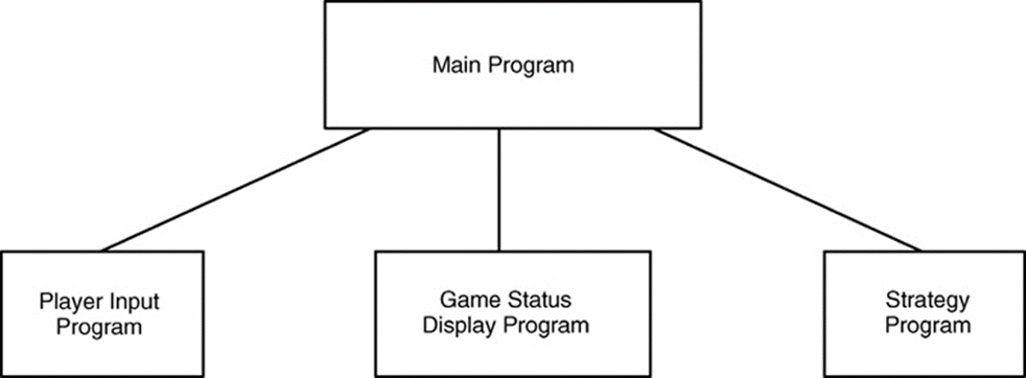
Structure Chart of a Game Program

Slide 12
Use of Flowcharts
Flowcharts are useful for developing and documenting programs that contain conditional statements, because they can display the various paths (called “branches”) that a program can take, depending on how the conditional statements are executed.

Slide 13
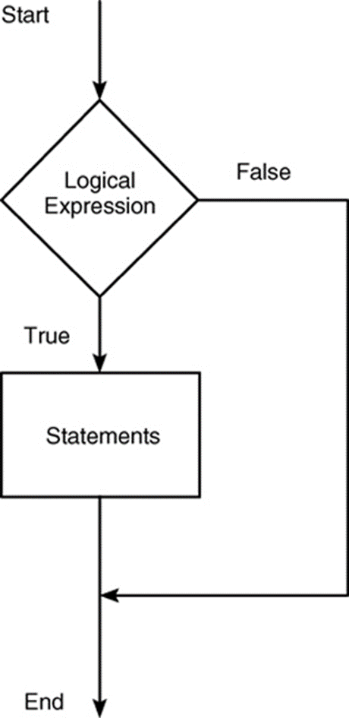
Flowchart representation of the if statement

Slide 14
Documenting with Pseudocode
We can document with pseudocode, in which natural language and mathematical expressions are used to construct statements that look like computer statements but without detailed syntax.
Each pseudocode instruction may be numbered, but should be unambiguous and computable.

Slide 15
Finding Bugs
Debugging a program is the process of finding and removing the “bugs,” or errors, in a program. Such errors usually fall into one of the following categories.
Syntax errors such as omitting a parenthesis or comma, or spelling a command name incorrectly. MATLAB usually detects the more obvious errors and displays a message describing the error and its location.
Errors due to an incorrect mathematical procedure. These are called runtime errors. They do not necessarily occur every time the program is executed; their occurrence often depends on the particular input data. A common example is division by zero.

Slide 16
Locating Runtime Errors
To locate a runtime error, try the following:
Always test your program with a simple version of the problem, whose answers can be checked by hand calculations.
Display any intermediate calculations by removing semicolons at the end of statements.
To test user-defined functions, try commenting out the function line and running the file as a script.
Use the debugging features of the Editor/Debugger, which is discussed in Section 4.8.

Slide 17
Development of Large Programs
Writing and testing of individual modules (the unit-testing phase).
Writing of the top-level program that uses the modules (the build phase). Not all modules are included in the initial testing. As the build proceeds, more modules are included.
Testing of the first complete program (the alpha release phase). This is usually done only in-house by technical people closely involved with the program development. There might be several alpha releases as bugs are discovered and removed.
Testing of the final alpha release by in-house personnel and by familiar and trusted outside users, who often must sign a confidentiality agreement. This is the beta release phase, and there might be several beta releases.

Slide 18
Relational Operators 1
Operator | Meaning
< | Less than.
<= | Less than or equal to.
> | Greater than.
>= | Greater than or equal to.
== | Equal to.
~= | Not equal to.

Slide 19
Relational Operators 2
For example, suppose that x = [6,3,9] and y = [14,2,9]. The following MATLAB session shows some examples.
>>z = (x < y)
z =
1 0 0
>>z = (x ~= y)
z =
1 1 0
>>z = (x > 8)
z =
0 0 1

Slide 20
Relational Operators 3
The relational operators can be used for array addressing.
For example, with x = [6,3,9] and y = [14,2,9], typing
z = x(x<y)
finds all the elements in x that are less than the corresponding elements in y. The result is z = 6.

Slide 21

Relational Operators 4
The arithmetic operators +, −, *, /, and vackslash have precedence over the relational operators. Thus the statement
z = 5 > 2 + 7
is equivalent to
z = 5 >(2+7)
and returns the result z = 0.
We can use parentheses to change the order of precedence; for example, z = (5 > 2) + 7 evaluates to z = 8.

Slide 22
The logical Class 1
When the relational operators are used, such as
x = (5 > 2)
they create a logical variable, in this case, x.
Logical is a first-class data type and a MATLAB class, and so logical is equivalent to other first-class types such as character and cell arrays.
Logical variables may have only the values 1 (true) and 0 (false).

Slide 23
The logical Class 2
Just because an array contains only 0s and 1s, however, it is not necessarily a logical array. For example, in the following session k and w appear the same, but k is a logical array and w is a numeric array, and thus an error message is issued.
>>x = −2:2; k = (abs(x)>1)
k =
1 0 0 0 1
>>z = x(k)
z =
−2 2
>>w = [1,0,0,0,1]; v = x(w)
??? Subscript indices must either be real positive... integers or logicals.

Slide 24
Accessing Arrays Using Logical Arrays 1
When a logical array is used to address another array, it extracts from that array the elements in the locations where the logical array has 1s.
So typing A(B), where B is a logical array of the same size as A, returns the values of A at the indices where B is 1.

Slide 25
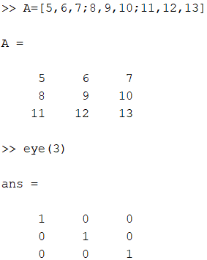
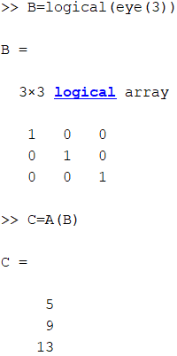
Accessing Arrays Using Logical Arrays 2
Specifying array subscripts with logical arrays extracts the elements that correspond to the true (1) elements in the logical array.
Given A =[5,6,7;8,9,10;11,12,13] and B = logical(eye(3)), we can extract the diagonal elements of A by typing C = A(B) to obtain C = [5;9;13].

Slide 26
Logical Operators 1
Operator | Name | Definition
~ | NOT | ~A returns an array the same dimension as A; the new array has ones where A is zero and zeros where A is nonzero
& | AND | A & B returns an array the same dimension as A and B; the new array has ones where both A and B have nonzero elements and zeros where either A or B is zero.
| | OR | A | B returns an array the same dimension as A and B; the new array has ones where at least one element in A or B is nonzero and zeros where A and B are both zero.

Slide 27
Logical Operators 2
Operator | Name | Definition
&& | Short-Circuit AND | Operator for scalar logical expressions. A && B returns true if both A and B evaluate to true, and false if they do not.
|| | Short-Circuit OR | Operator for scalar logical expressions. A || B returns true if either A or B or both evaluate to true, and false if they do not.

Slide 28
Order of Precedence for Operator Types
Precedence | Operator type
First | Parentheses; evaluated starting with the innermost pair.
Second | Arithmetic operators and logical NOT (~); evaluated from left to right.
Third | Relational operators; evaluated from left to right.
Fourth | Logical AND.
Fifth | Logical OR.

Slide 29
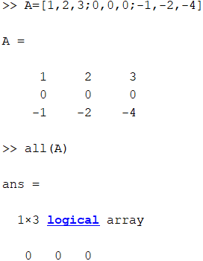
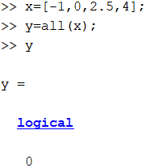
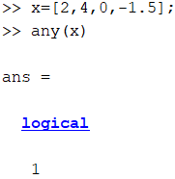
Logical Functions 1
Logical function | Definition
all(x) | Returns a scalar, which is 1 if all the elements in the vector x are nonzero and 0 otherwise.
all(A) | Returns a row vector having the same number of columns as the matrix A and containing ones and zeros, depending on whether or not the corresponding column of A has all nonzero elements.
any(x) | Returns a scalar, which is 1 if any of the elements in the vector x is nonzero and 0 otherwise.

Slide 30
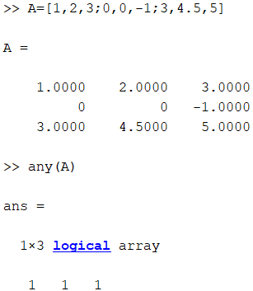
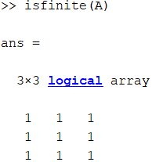
Logical Functions 2
Logical function | Definition
any(A) | Returns a row vector having the same number of columns as A and containing ones and zeros, depending on whether or not the corresponding column of the matrix A contains any nonzero elements.
isfinite(A) | Returns an array of the same dimension as A with ones where the elements of A are finite and zeros elsewhere.

Slide 31
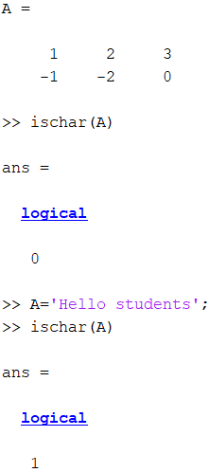
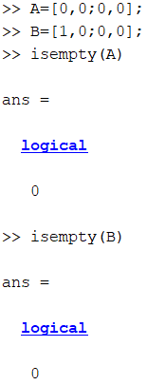
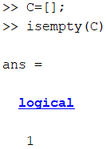
Logical Functions 3
Logical function | Definition
ischar(A) | Returns a 1 if A is a character array and 0 otherwise.
isempty(A) | Returns a 1 if A is an empty matrix and 0 otherwise.

Slide 32
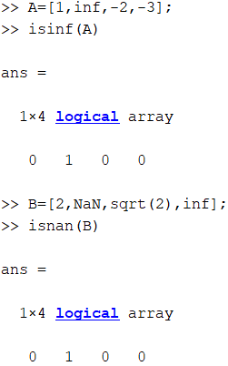
Logical Functions 4
Logical function | Definition
isinf(A) | Returns an array of the same dimension as A, with ones where A has 'inf' and zeros elsewhere.
isnan(A) | Returns an array of the same dimension as A with ones where A has 'NaN' and zeros elsewhere. ('NaN' stands for “not a number,” which means an undefined result.)

Slide 33
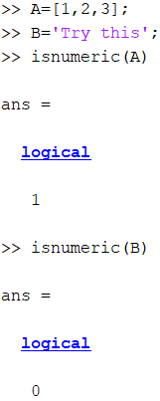
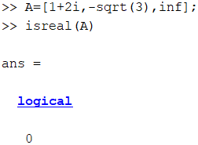
Logical Functions 5
isnumeric(A) | Returns a 1 if A is a numeric array and 0 otherwise.
isreal(A) | Returns a 1 if A has no elements with imaginary parts and 0 otherwise.

Slide 34
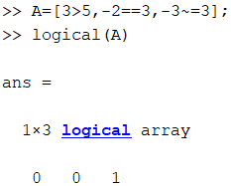
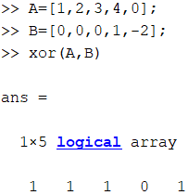
Logical Functions 6
logical(A) | Converts the elements of the array A into logical values.
xor(A,B) | Returns an array the same dimension as A and B; the new array has ones where either A or B is nonzero, but not both, and zeros where A and B are either both nonzero or both zero.

Slide 35
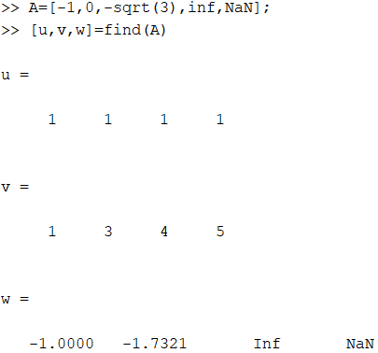
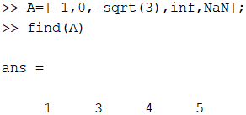
The find Function
find(A) | Computes an array containing the indices of the nonzero elements of the array A.
[u,v,w] = find(A) | Computes the arrays u and v containing the row and column indices of the nonzero elements of the array A and computes the array w containing the values of the nonzero elements. The array w may be omitted.

Slide 36
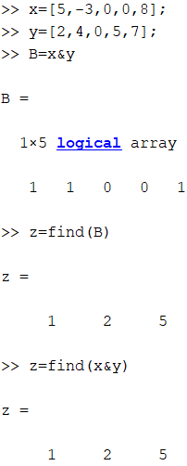
Logical Operators and the find Function 1
Consider the session
>>x = [5, −3, 0, 0, 8];
>>y = [2, 4, 0, 5, 7];
>>z = find(x&y)
z =
1 2 5
Note that the find function returns the indices, and not the values.

Slide 37
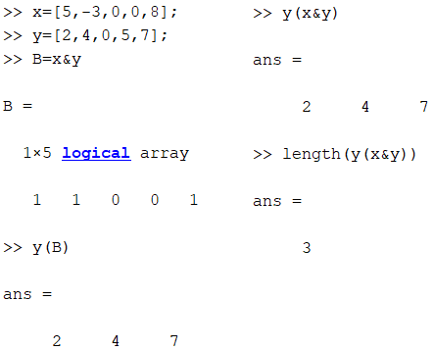
Logical Operators and the find Function 2
In the following session, note the difference between the result obtained by y(x&y) and the result obtained by find(x&y) in the previous slide.
>>x = [5, −3, 0, 0, 8];
y = [2, 4, 0, 5, 7];
>>values = y(x&y)
values = 2 4 7
>>how_many = length(values)
how_many = 3

Slide 38
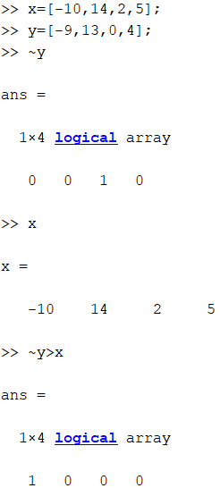
Question 1
If x = [-10,14,2,5] and y = [-9,13,0,4], what will be the result of the ~y > x.
1 0 0 0 (correct)
1 1 1 1
1 1 1 0
0 1 1 1
38

Slide 39
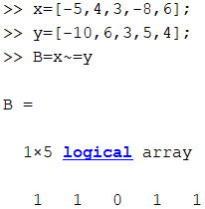
Question 2
Suppose that x = [-5,4,3,-8,6] and y = [-10,6,3,5,4]. What is the result of the B = (x ~= y) operation?
1 1 1 1 1
1 1 1 0 0
1 1 0 1 1 (correct)
1 1 0 0 1
39

Slide 40
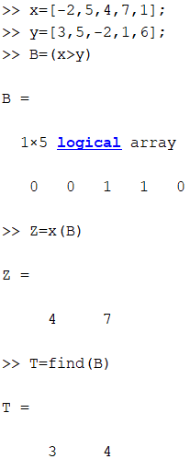
Question 3
Suppose that x = [-2,5,4,7,1] and y = [3,5,-2,1,6]. Use MATLAB to find the indices of the elements in x that are greater than the corresponding elements in y.
1 2 5
3 4 (correct)
2 3
1 3 5
40

Slide 41
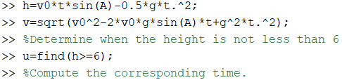
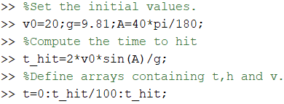
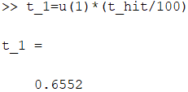
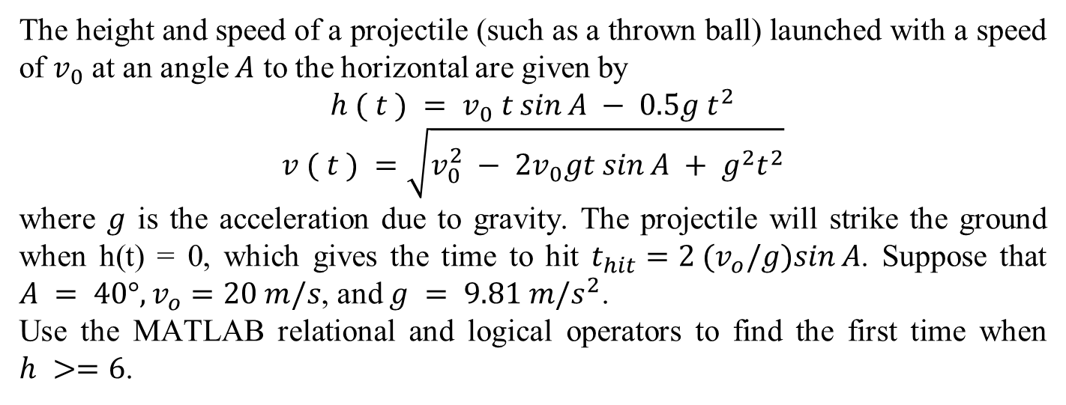
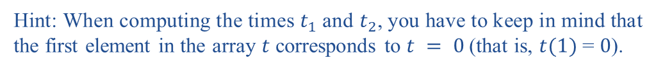
Question 4
The height and speed of a projectile (such as a thrown ball) launched with a speed of $v_{0}$ at an angle $A$ to the horizontal are given by
$$h ( t ) = v_{0} t sin⁡A − 0.5g t^{2}$$
$$v ( t ) =\sqrt{v_{0}^{2} − 2v_{0}gt sin⁡A + g^{2}t^{2}}$$
where $g$ is the acceleration due to gravity. The projectile will strike the ground when h(t) = 0, which gives the time to hit $t_{hit}=2 (v_{o}/g)sin⁡A$. Suppose that $A = 40°,v_{o}=20 m/s$, and $g = 9.81 m/s^{2}$.
Use the MATLAB relational and logical operators to find the first time when $h >=6$.
Hint: When computing the times $t_{1}$ and $t_{2}$, you have to keep in mind that the first element in the array $t$ corresponds to $t = 0$(that is, $t(1)$ = $0$).
41

Slide 42
The if Statement
The if statement’s basic form is
if logical expression
statements
end
Every if statement must have an accompanying end statement. The end statement marks the end of the statements that are to be executed if the logical expression is true.

Slide 43
The else Statement
The basic structure for the use of the else statement is
if logical expression
statement group 1
else
statement group 2
end

Slide 44
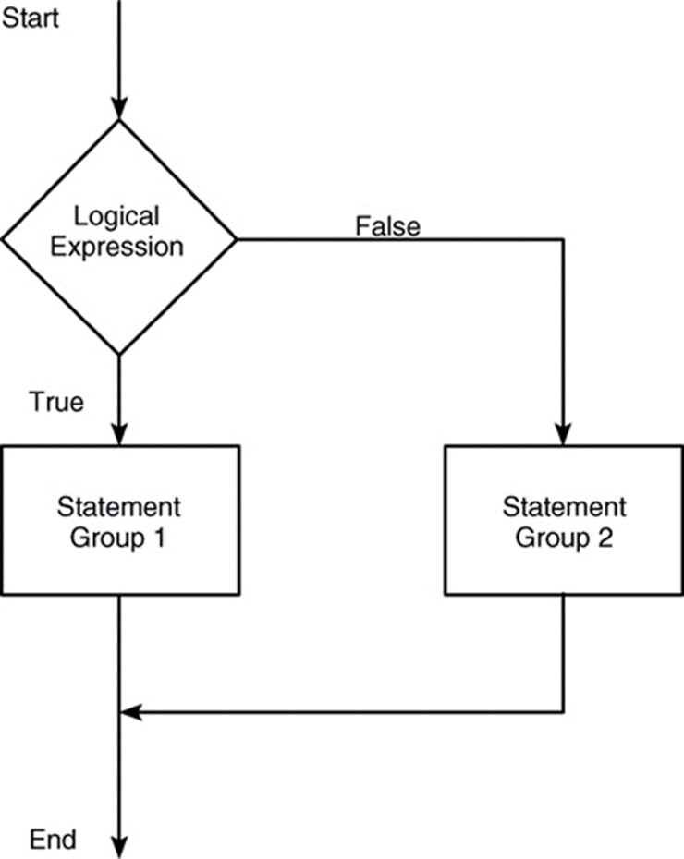
Flowchart of the else Structure

Slide 45
The Logical Expression in the else Structure 1
The logical expression may be an array. If so, the test returns a value of true only if all the elements of the logical expression are true!

Slide 46
The Logical Expression in the else Structure 2
For example, if we fail to recognize how the test works, the following statements do not perform the way we might expect.
x = [4, −9,25];
if x < 0
disp(‘All elements of x are negative.’)
else
y = sqrt(x)
end
When this program is run it gives the result
y = 2 0 + 3.000i 5

Slide 47
The Logical Expression in the else Structure 3
Instead, consider what happens if we test for x positive.
x = [4, −9,25];
if x >= 0
y = sqrt(x)
else
disp(’Some of the elements of x are negative.’)
end
When executed, it produces the following message:
Some of the elements of x are negative.
The test if x < 0 is false, and the test if x >= 0 also returns a false value because x >= 0 returns the vector [1,0,1].

Slide 48
Making Statements Concise
if logical expression 1
if logical expression 2
statements
end
end
can be replaced with the more concise program
if logical expression 1 & logical expression 2
statements
end

Slide 49
The elseif Statement
The general form of the if statement is
if logical expression 1
statement group 1
elseif logical expression 2
statement group 2
else
statement group 3
end
The else and elseif statements may be omitted if not required. However, if both are used, the else statement must come after the elseif statement to take care of all conditions that might be unaccounted for.

Slide 50
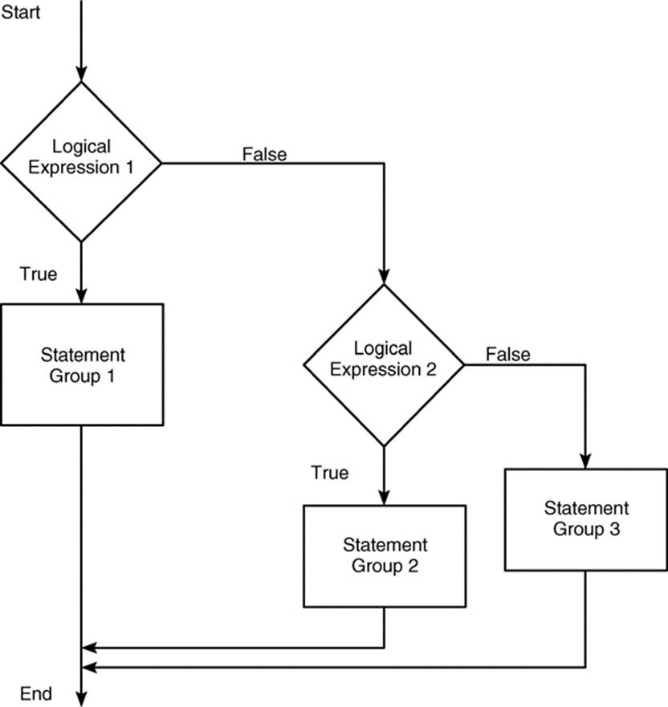
Flowchart for the General if-elseif-else Structure
Access the text alternative for slide images.

Slide 51
Example of an if-elseif-else Structure
For example, suppose that y = log(x)
for x > 10, y =sqrt(x) for 0 <= x <= 10,
and y = exp(x) − 1 for x < 0.
The following statements will compute y if x already has a scalar value.
if x > 10
y = log(x)
elseif x >= 0
y = sqrt(x)
else
y = exp(x) − 1
end

Slide 52
Strings and Conditional Statements 1
A string is a variable that contains characters. Strings are useful for creating input prompts and messages and for storing and operating on data such as names and addresses.
To create a string variable, enclose the characters in single quotes. For example, the string variable name is created as follows:
>>name = ‘Leslie Student’
name =
Leslie Student

Slide 53
Strings and Conditional Statements 2
The following string, number, is not the same as the variable number created by typing number = 123.
>>number = ‘123’
number =
123

Slide 54
Strings and Conditional Statements 3
The following prompt program uses the isempty(x) function, which returns a 1 if the array x is empty and 0 otherwise.
It also uses the input function, whose syntax is
x = input(‘prompt’, ‘string’)
This function displays the string prompt on the screen, waits for input from the keyboard, and returns the entered value in the string variable x.
The function returns an empty matrix if you press the Enter key without typing anything.

Slide 55
Strings and Conditional Statements 4
The following prompt program is a script file that allows the user to answer Yes by typing either Y or y or by pressing the Enter key. Any other response is treated as a No answer.
response = input(‘Do you want to continue? Y/N [Y]: ’,‘s’);
if (isempty(response))|(response == ‘Y’)|(response == ‘y’)
response = ‘Y’
else
response = ‘N’
end

Slide 56
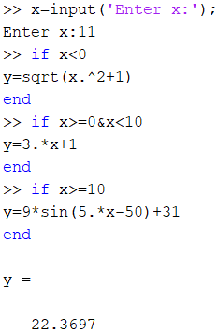
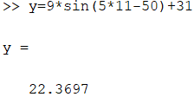
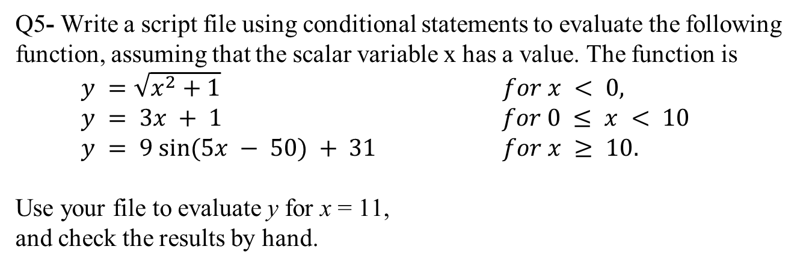
Question 5
Q5- Write a script file using conditional statements to evaluate the following
function, assuming that the scalar variable x has a value. The function is
$y =\sqrt{x^{2}+1}$ $for x < 0,$
$$y = 3x + 1 for 0 ≤ x < 10$$
$$y = 9 sin⁡(5x − 50) + 31 for x ≥ 10.$$
Use your file to evaluate y for x = 11,
and check the results by hand.

Slide 57
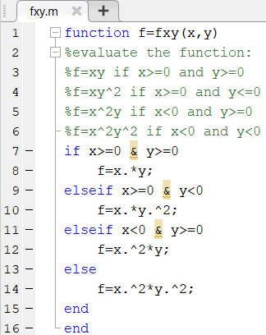
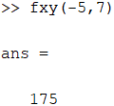
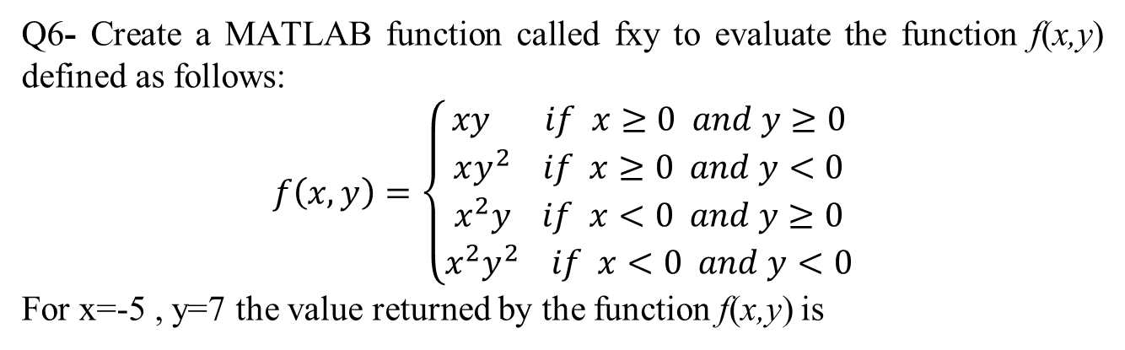
Question 6
Q6- Create a MATLAB function called fxy to evaluate the function f(x,y) defined as follows:
$$f\left(x,y\right)=\left\{\begin{aligned}xy if x≥0 and y≥0 \\ xy^{2} if x≥0 and y<0 \\ x^{2}y if x<0 and y≥0 \\ x^{2}y^{2} if x<0 and y<0\end{aligned}\right.$$
For x=-5 , y=7 the value returned by the function f(x,y) is

Slide 58
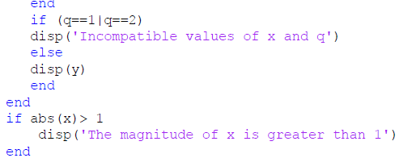
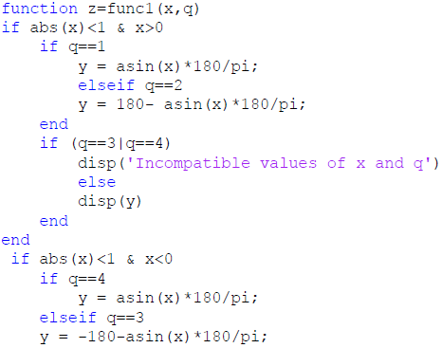

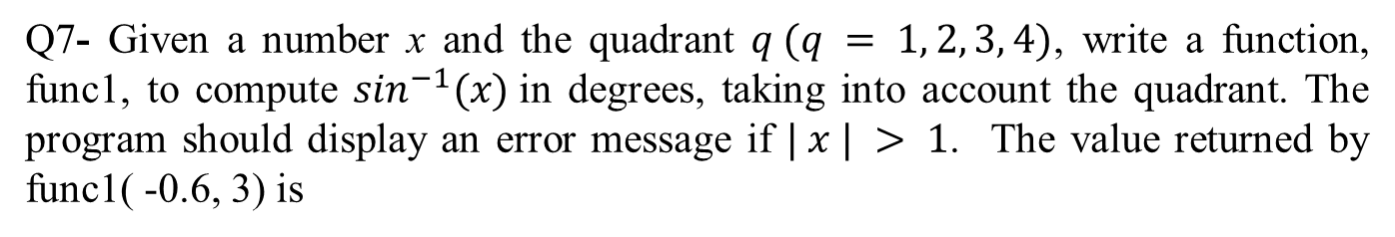
Question 7
Q7- Given a number x and the quadrant $q (q = 1, 2, 3, 4)$, write a function, func1, to compute $\sin^{−1}(x)$in degrees, taking into account the quadrant. The program should display an error message if $| x | > 1$. The value returned by func1( -0.6, 3) is

Slide 59
for Loops
A simple example of a for loop is
for k = 5:10:35
x = k^2
end
The loop variable k is initially assigned the value 5, and x is calculated from x = k^2. Each successive pass through the loop increments k by 10 and calculates x until k exceeds 35. Thus, k takes on the values 5, 15, 25, and 35, and x takes on the values 25, 225, 625, and 1225. The program then continues to execute any statements following the end statement.

Slide 60
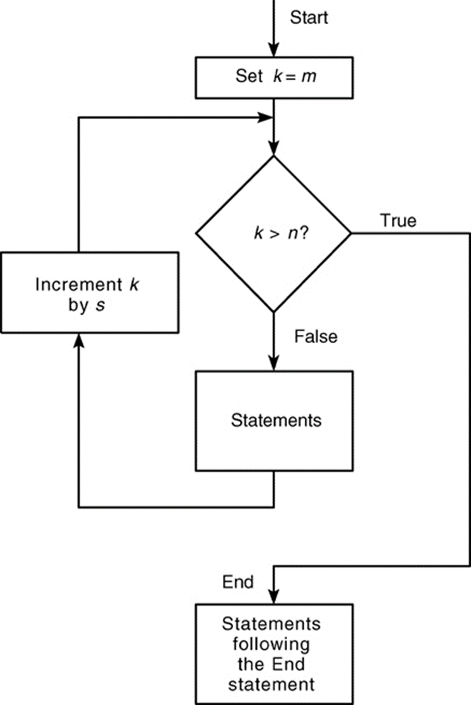
Flowchart of a for Loop
Access the text alternative for slide images.

Slide 61
Loop Variable Expression 1
Note the following rules when using for loops with the loop variable expression k = m:s:n:
The step value s may be negative. Example: k = 10: −2:4 produces k = 10, 8, 6, 4.
If s is omitted, the step value defaults to one.
If s is positive, the loop will not be executed if m is greater than n.
If s is negative, the loop will not be executed if m is less than n.
If m equals n, the loop will be executed only once.
If the step value s is not an integer, round-off errors can cause the loop to execute a different number of passes than intended.

Slide 62
Loop Variable Expression 2
For example, the following code uses a continue statement to avoid computing the logarithm of a negative number.
x = [10,1000,−10,100];
y = NaN*x;
for k = 1:length(x)
if x(k) < 0
continue
end
y(k) = log10(x(k));
end
y
The result is y = 1, 3, NaN, 2.

Slide 63
Using a Logical Array as a Mask
We can often avoid the use of loops and branching and thus create simpler and faster programs by using a logical array as a mask that selects elements of another array. Any elements not selected will remain unchanged.
The following session creates the logical array C from the numeric array A given previously.
>>A = [0, −1, 4; 9, −14, 25; −34, 49, 64];
>>C = (A >= 0);
The result is

Slide 64
Example of the Mask Technique
We can use this mask technique to compute the square root of only those elements of A given in the previous program that are no less than 0 and add 50 to those elements that are negative. The program is
A = [0, −1, 4; 9, − 4, 25; −34, 49, 64];
C = (A >= 0);
A(C) = sqrt(A(C))
A(~C) = A(~C) + 50

Slide 65
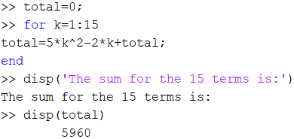
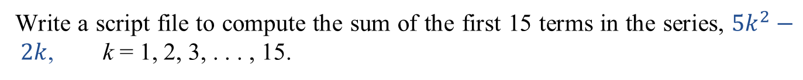
Question 8
Write a script file to compute the sum of the first 15 terms in the series, $5k^{2}− 2k$, k = 1, 2, 3, . . . , 15.
5960 (correct)
1815
6643
3983

Slide 66
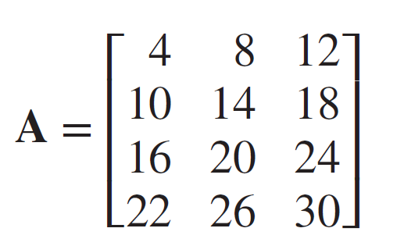
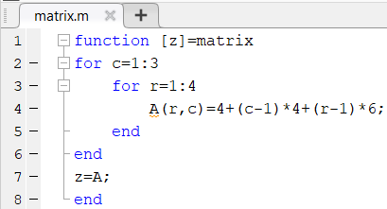
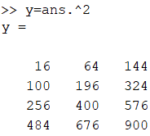

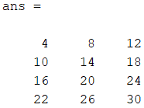
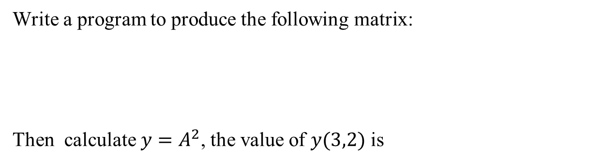
Question 9
Write a program to produce the following matrix:
Then calculate $y=A^{2}$, the value of $y(3,2)$ is
400 (correct)
576
600
900

Slide 67
while Loops
The while loop is used when the looping process terminates because a specified condition is satisfied, and thus the number of passes is not known in advance. A simple example of a while loop is
x = 5;
while x < 25
disp(x)
x = 2*x − 1;
end
The results displayed by the disp statement are 5, 9, and 17.

Slide 68
The Typical Structure of a while Loop
while logical expression
statements
end
For the while loop to function properly, the following two conditions must occur:
The loop variable must have a value before the while statement is executed.
The loop variable must be changed somehow by the statements.

Slide 69
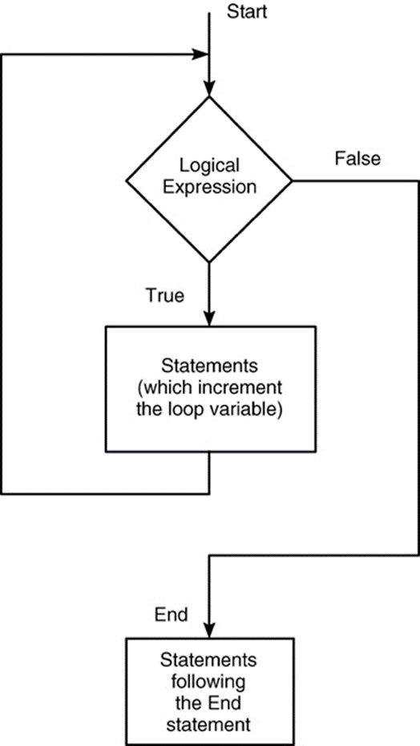
Flowchart of the while Loop

Slide 70
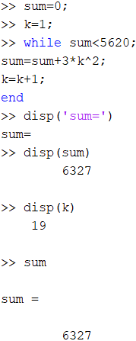

Question 10
Use a while loop to determine how many terms in the series $3k^{2}$, $k =1, 2, 3, . . . ,$ are required for the sum of the terms to exceed 5620. What is the sum for this number of terms?
25, 9327
21, 7753
19, 6327 (correct)
17, 4315

Slide 71


Question 11
Use a while loop to find two decimal places the largest value of x before the error in the $e^{x}≈1+x+\frac{x^{2}}{2}+\frac{x^{3}}{6}$ exceeds 15 percent.
0.89
2.04 (correct)
1.75
3.21

Slide 72
The switch Structure
The switch structure provides an alternative to using the if, elseif, and else commands. Anything programmed using switch can also be programmed using if structures.
However, for some applications the switch structure is more readable than code using the if structure.

Slide 73
Syntax of the switch Structure
switch input expression (can be a scalar or string).
case value1
statement group 1
case value2
statement group 2
.
.
.
otherwise
statement group n
end

Slide 74
Example of the switch Structure
The following switch block displays the point on the compass that corresponds to that angle.
switch angle
case 45
disp(‘Northeast’)
case 135
disp(‘Southeast’)
case 225
disp(‘Southwest’)
case 315
disp(‘Northwest’)
otherwise
disp(‘Direction Unknown’)
end

Slide 75
End of Main Content
© McGraw Hill LLC. All rights reserved. No reproduction or distribution without the prior written consent of McGraw Hill LLC.

